Slide 1






A Unified Big Data and NLP Platform for Enhancing Rural Education in India
Capstone
Project
Presented by: Akhil Miriyala
24MBMB37
MBA BUSINESS ANALYTICS

Slide 2

Table of Contents
  Project Overview
  Case 1 – Career Guidance Analytics
  Case 2 – Dropouts Analysis
  Case 3 – Scholarship Awareness
  Case 4 – Language Barriers
  Case 5 – Learning Outcome Gaps
  Unified Big Data Architecture
  ETL Workflow & Data Flow

Slide 3
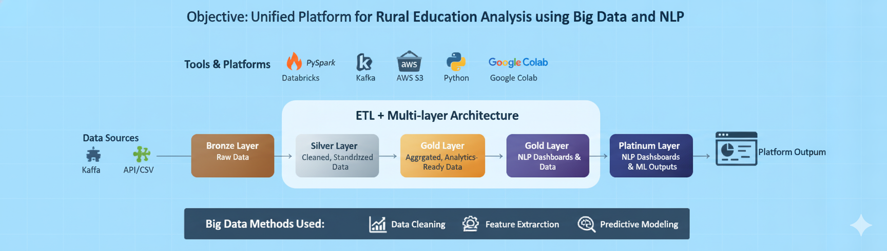
Project Overview
  Objective: Build a unified platform analyzing rural education issues using Big Data and NLP.
  Tools & Platforms: Databricks, PySpark, Python, Google Colab
  Architecture: ETL + Multi-layer (Bronze, Silver, Gold, Platinum)
  Big Data Methods: Data Cleaning, Aggregation, Feature Extraction, Predictive Modeling

Slide 4
Tools Used
  For data ingestion, they either read from CSV files directly into pandas DataFrames or, in one case, attempt to scrape live web data using the requests library (to fetch HTML) and BeautifulSoup (to parse it).
  After initial handling in pandas, the data is converted into a PySpark DataFrame, making Apache Spark the main engine for all large-scale, distributed processing.
  PySpark MLlib library is used extensively for all machine learning tasks, including feature engineering (like StringIndexer)
  Training/evaluating classification models like RandomForestClassifier.
  Spark SQL is also used to define table schemas and run queries, while Databricks Utilities (dbutils) are used to add platform-specific features like interactive widgets.

Slide 5

Case 1 – Career Guidance Analytics
•Goal: Analyze students’ academic interests and aptitude for career alignment.
•Dataset Source: Synthetic (based on NCS & Skill India Portal)
•ETL Steps: Referred and generated in google colab → PySpark Transform → Delta Load
•Feature Extraction: Interest Index, Skill Level, Parental Influence
•
•Transformations: Encoding interests, removing nulls, mapping skills to jobs
•Big Data Layers: Silver (cleaned), Gold (aggregated), Platinum (NLP chatbot)
•Output: Top 10 Career Trends Dashboard + Recommendation Chatbot

Slide 6
Case 2 – School Dropouts Analysis
•Goal: Identify dropout patterns using socio-economic and academic data.
•Dataset Source: UDISE+ and synthetic demographics (1 lakh records od students data from 2014-2024)
•ETL: PySpark DataFrame → Cleaning → Categorization → Load to Delta
•Feature Extraction: Attendance %, Family Income Bracket, School Type
•
•Transformations: Normalization, outlier removal, classification encoding
•Big Data Layers: Gold (Dropout prediction ML model), Platinum (Heatmaps)
•Output: Predictive model for dropout risk visualization

Slide 7
Case 3 – Scholarship Awareness
•Goal: Bridge scholarship awareness and eligibility gaps.
•Dataset Source: NSP, State Portals, and Grok-generated data
•ETL: Web scraping (BeautifulSoup) → PySpark → Delta Storage
•Feature Extraction: Eligibility Criteria, Caste, Income Group, Gender
•Transformations: Text cleaning, filtering, structuring by type/state
•Big Data Layers: Silver (eligibility table), Gold (distribution map), Platinum (NLP Q&A)
•Output: Scholarship Recommendation based on input detail

Slide 8
Case 4 – Language Barriers
•Goal: Analyze language’s effect on learning outcomes.
•Dataset Source: NCERT & translated proficiency datasets
•ETL: Load CSV → NLP normalization → Spark Processing
•Feature Extraction: Language Code, Subject Performance, Region
•Transformations: Text normalization, encoding, correlation mapping
•Big Data Layers: Gold (performance correlation), Platinum (sentiment analysis)
•Output: Comparison of native vs non-native language performance

Slide 9
Case 5 – Learning Outcome Gaps
•Goal: Detect learning gaps using test and attendance metrics.
•Dataset Source: ASER + UDISE+ + synthetic data
•ETL: Ingest unified dataset → Transform scores → Delta load
•Feature Extraction: Learning Index, Subject Score, Attendance Ratio
•Transformations: Standardization, KPI derivation, missing value handling
•Big Data Layers: Gold (KPI results), Platinum (visual dashboards)
•Output: KPI dashboards for subject-wise learning gap insights

Slide 10

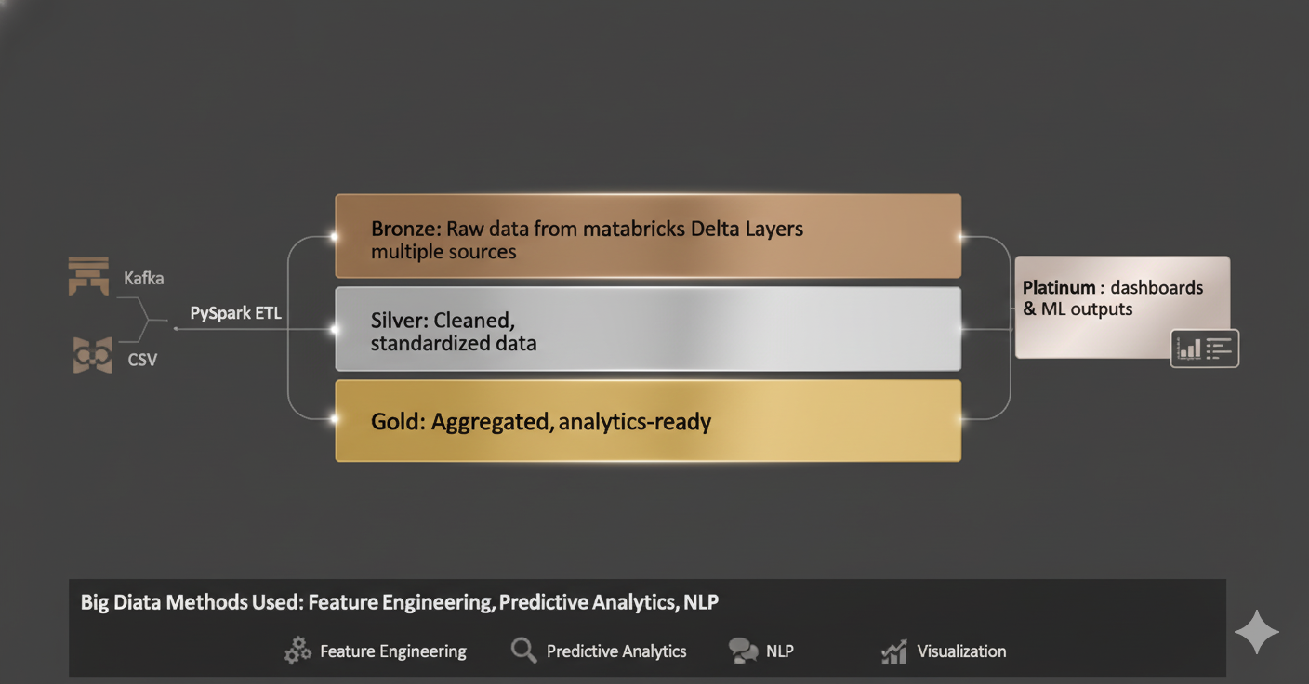
Unified Big Data Architecture

Slide 11
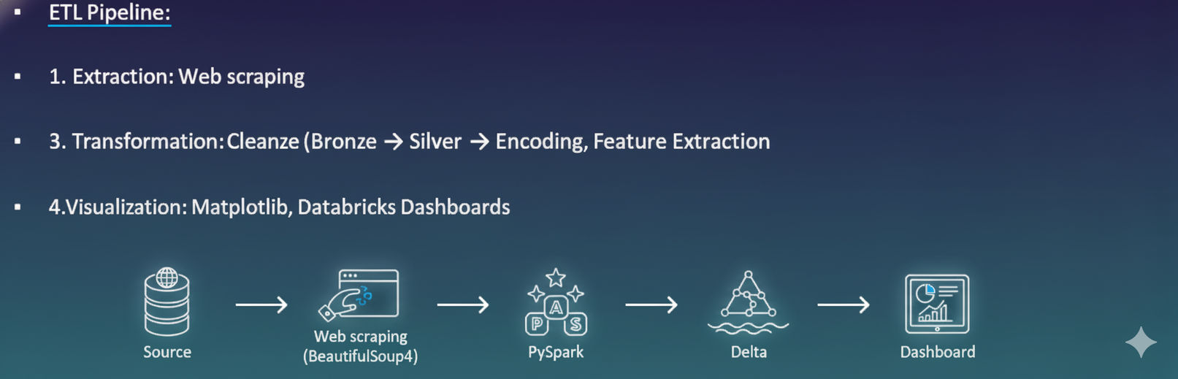
ETL Workflow & Data Flow

Slide 12

Thank's For Watching

